Slide 1
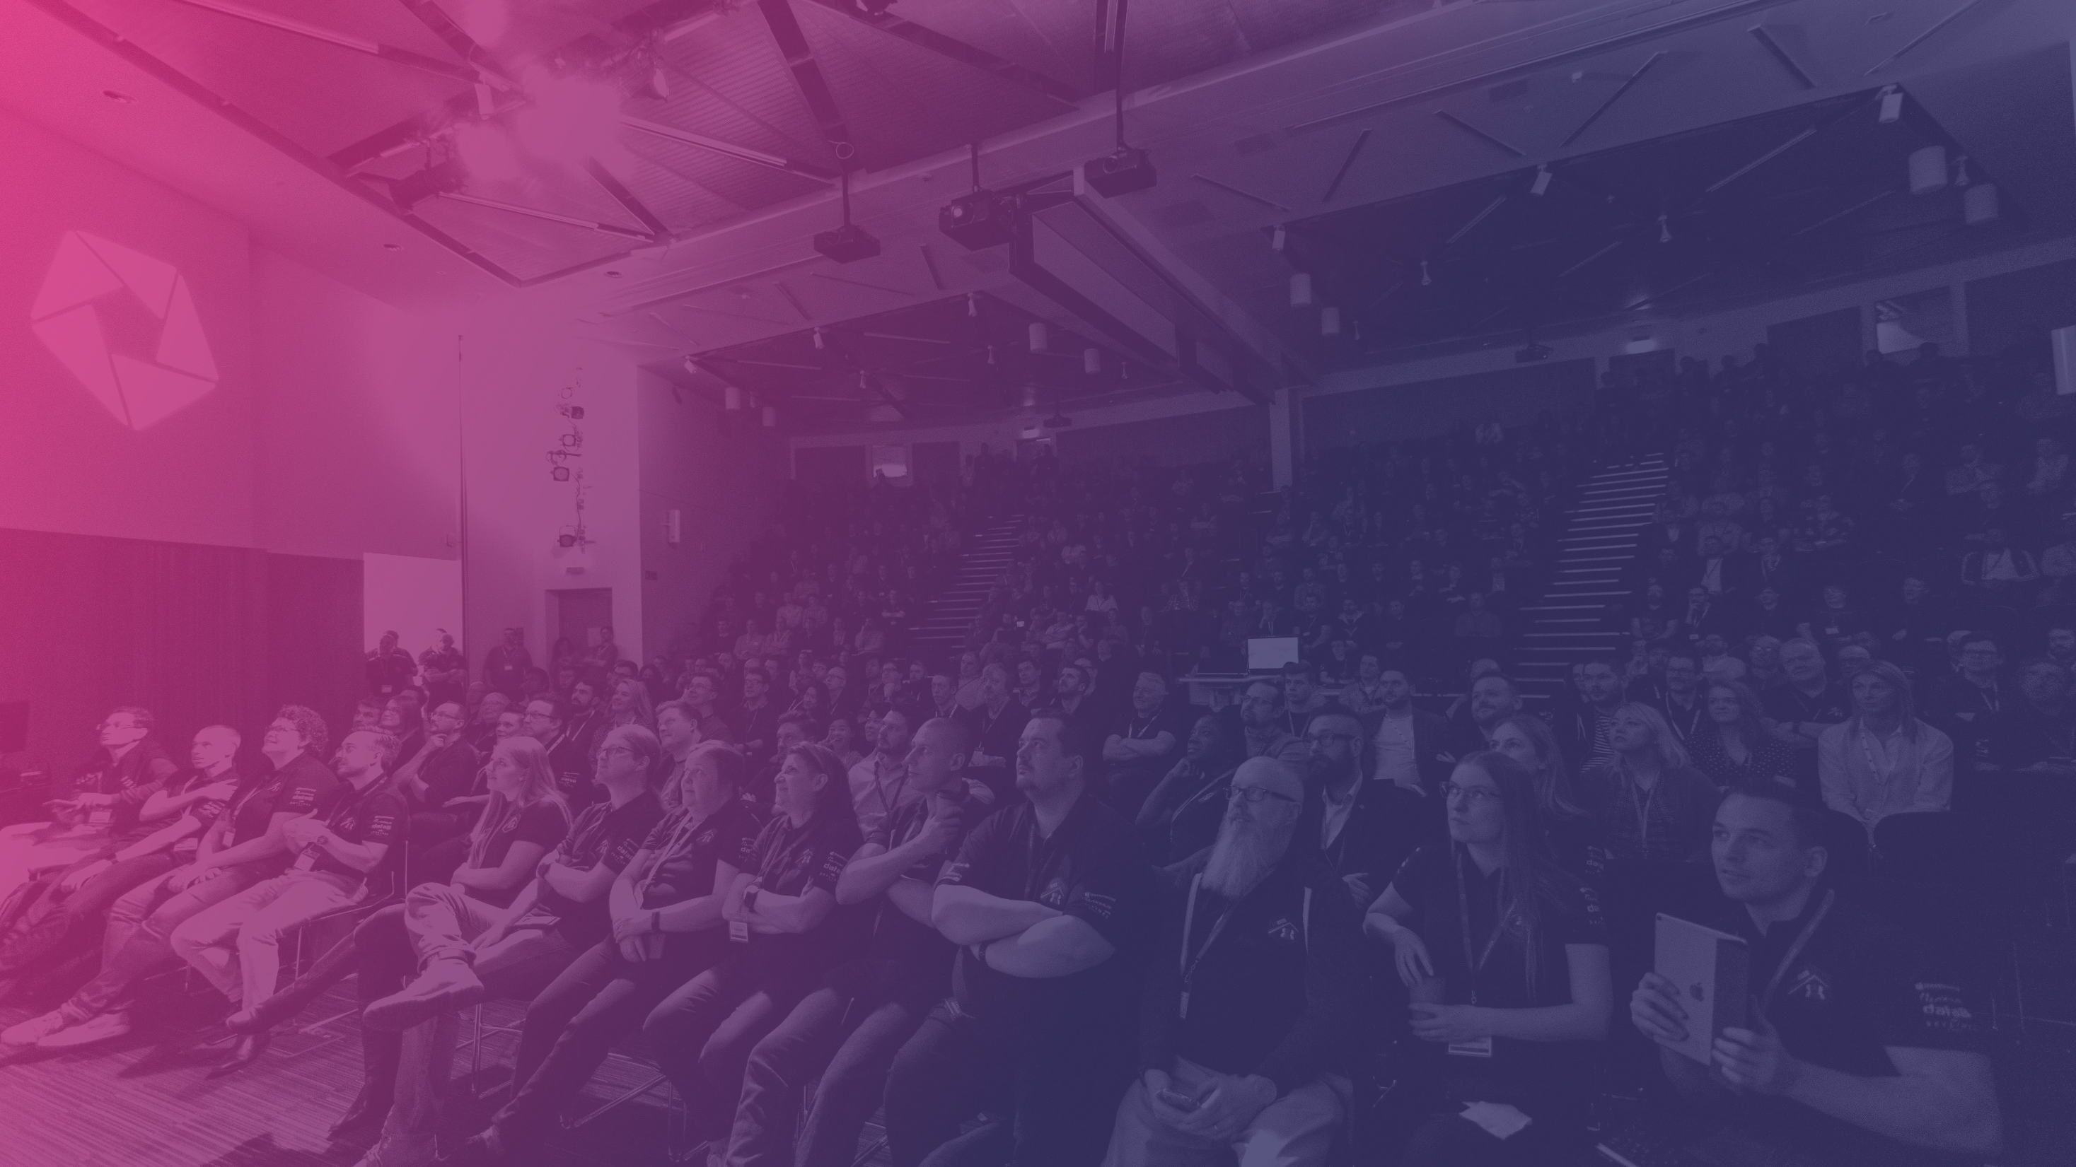

#ScottishSummit2021
Anuradha Kumari
Inaccessible websites?
It’s us, not JavaScript
Nairn (18:30 GMT)

Slide 2







Our Sponsors

Slide 3
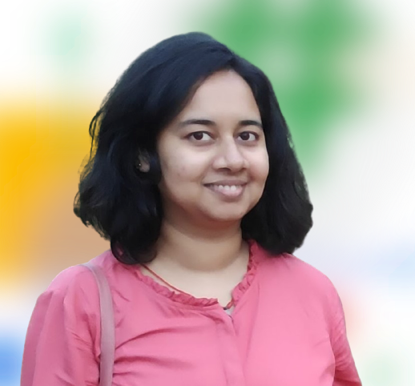
Anuradha
Kumari
Mediaocean
Development Specialist
@miracle_404
in/anuradha15

Slide 4
Topics we will cover:
Introduction to accessibility
JavaScript to enhance accessibility
Testing using tools and extensions

Slide 5
Accessibility ( A11Y )
Making resources and services usable by everyone

Slide 6
WHO reports
15% of world population lives with some form of disability

Slide 7
Types of disabilities
Visual
Auditory
Motor
Cognitive

Slide 8
A11Y is more than disabilities
Technical ( slow internet connection )
Smaller Devices
Situational ( bright environment )
Progressive ( aging )

Slide 9

Accessibility benefits everyone

Slide 10
How does JavaScript impact Accessibility?

Slide 11
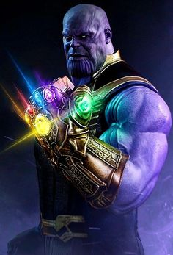
JavaScript
is like
Infinity Gauntlet
MARVEL UNIVERSE
With great Power, comes greater responsibility

Slide 12

Tony Stark

Slide 13
4 principles
O
P
R
U
Perceivable
Operable
Robust
Understandable
Notes:
Perceivable - Information and user interface components must be presentable to users in ways they can perceive.
This means that users must be able to perceive the information being presented (it can't be invisible to all of their senses)
Operable - User interface components and navigation must be operable.
This means that users must be able to operate the interface
Understandable - Information and the operation of user interface must be understandable.
Robust - Content must be robust enough that it can be interpreted reliably by a wide variety of user agents, including assistive technologies.
This means that users must be able to access the content as technologies advance (as technologies and user agents evolve, the content should remain accessible)

Slide 14
Demo #1
Using Semantic HTML
explore-a11y.netlify.app/button

Slide 15
Demo #2
Keyboard Accessibility
explore-a11y.netlify.app/modal

Slide 16
Demo #3
Announce Dynamic Changes
explore-a11y.netlify.app/announce-details

Slide 17
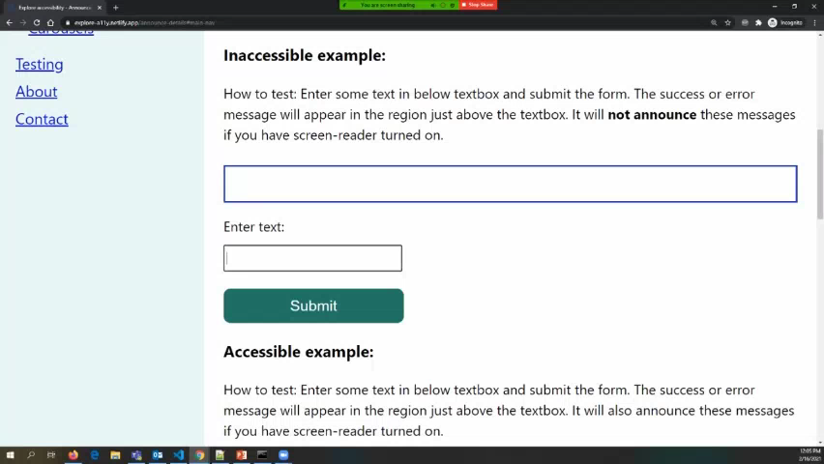

Slide 18
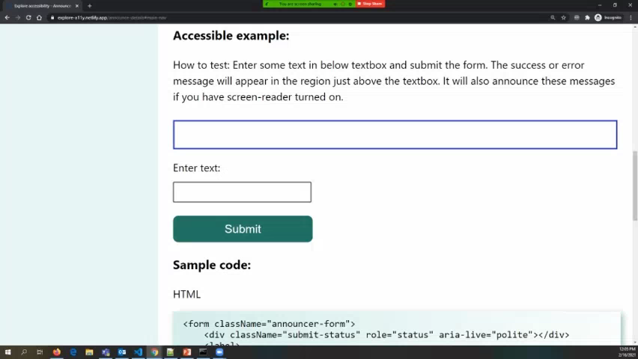

Slide 19
Demo #4
Respect User Device Settings
explore-a11y.netlify.app/animation

Slide 20

Testing for a11y
Unplug the mouse
Screen readers
Use tools to audit
Consult Real Users

Slide 21
Screen Readers
NVDA - Windows, Free
Mac voiceover utility - Mac OS, Free
ORCA - Linux
JAWS - Paid

Slide 22
Lighthouse
Axe Extension
Accessibility Pane
Wave extension
NoCoffee
Tools and extensions

Slide 23
Ask 2 Questions:
Can Users
ACCESS
it?
Does it have
ABILITY
to be usable?

Slide 24
Focus on accessibility just as everything else.

Slide 25
To create an inclusive web,
we need your help

Slide 26
Action Items:
Pass on the learnings,
Let’s spread the awareness

Slide 27
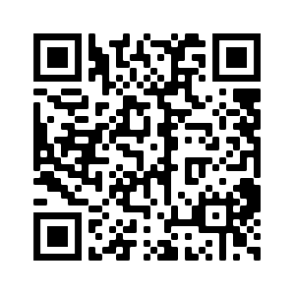
Scan QR code
or visit
github.com/anuk79/tech-talks-links

Slide 28
Resources
W3C Web Accessibility Initiative / WAI
WAI-ARIA Authoring practices
WebAIM checklist
Explore accessibility website - used in today's demos

Slide 29
Thank You
#ScottishSummit2021

